Slide 1

Lab 1 & Lab 2: Introduction to Java Programming
A comprehensive guide for beginners learning Java fundamentals and object-oriented concepts
Lect. Saad Mazhar Khan | Date 17-09-2025

Slide 2

Lab 1: Introduction to Java
Welcome to your first Java lab! Today we'll explore the fundamentals of Java programming, from understanding what Java is to writing your first programs. This lab will give you the foundation you need to start your programming journey.
By the end of this session, you'll understand Java's core concepts, have it installed on your system, and write your first programs using basic syntax and data types.

Slide 3

What is Java?
A Brief History
Java was developed by James Gosling at Sun Microsystems in 1995. Originally called "Oak," it was designed for interactive television but proved too advanced for the cable TV industry at the time.
The name "Java" comes from Java coffee, reflecting the team's love for coffee during development. Sun Microsystems was later acquired by Oracle Corporation in 2010.
Key Applications
Web applications (server-side)
Mobile apps (Android development)
Desktop applications
Enterprise software
Scientific applications

Slide 4
Why Use Java?
Platform Independence
Security
"Write Once, Run Anywhere" - Java code runs on any device with a Java Virtual Machine, from Windows to Linux to Mac.
Built-in security features protect against viruses and malicious code. No explicit pointers and runtime checking prevent many common errors.
Large Community
Object-Oriented
Massive developer community means abundant resources, libraries, frameworks, and support for learning and problem-solving.
Clean, modular programming approach that makes code more organized, reusable, and easier to maintain as projects grow.

Slide 5
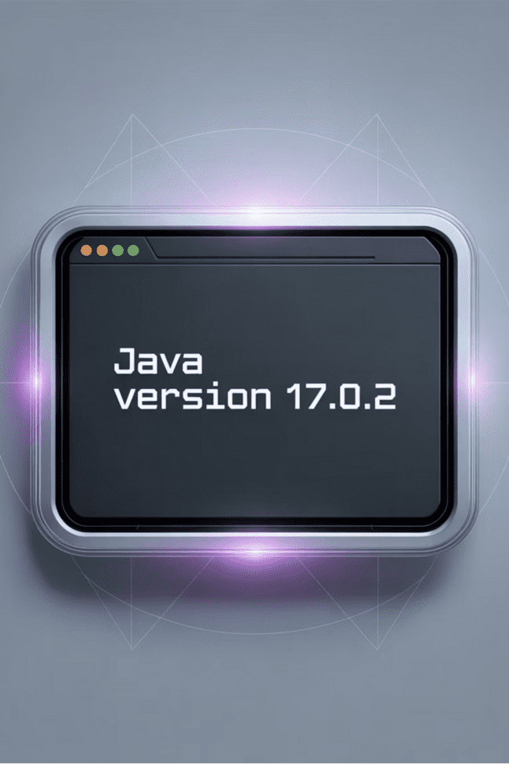
Installing Java
01
Download JDK
Visit Oracle's website and download the latest Java Development Kit (JDK) for your operating system. Choose the appropriate version for your system architecture.
02
Run Installation
Execute the downloaded installer and follow the setup wizard. Accept the license agreement and choose your installation directory.
03
Set Environment Variables
Configure JAVA_HOME and add Java to your system PATH. This allows you to run Java commands from any directory.
04
Verify Installation
Open command prompt/terminal and type java -version. You should see version information confirming successful installation.

Slide 6
JDK vs JRE vs JVM
Component
Full Name
Purpose
Contains
JDK
Java Development Kit
Complete development environment
JRE + development tools (compiler, debugger)
JRE
Java Runtime Environment
Runtime environment for Java apps
JVM + standard libraries + runtime support
JVM
Java Virtual Machine
Executes Java bytecode
Platform-specific runtime engine
Key Point: Developers need JDK to write and compile code. End users only need JRE to run Java applications. JVM is the core engine that makes Java platform-independent.

Slide 7


Java Basic Syntax
Hello World Example
public class HelloWorld
{
public static void main(String[] args)
{
System.out.println("Hello, World!"); }
}
Important Rules
File Naming: If your class is named "HelloWorld", your file must be saved as "HelloWorld.java" - exact match including capitalization!
File name must match class name
Java is case-sensitive
Every statement ends with semicolon
Blocks defined by curly braces { }

Slide 8
The main() Method & System.out.println()
main() Method Breakdown
System.out.println() Explained
System: Built-in Java class
public static void main(String[] args)
out: Standard output stream
println(): Print line method
public: Accessible from anywhere
Automatically adds newline after text
static: Can run without creating object
void: Returns nothing
Alternative: System.out.print() doesn't add newline
String[] args: Command line arguments
The main() method is your program's entry point - where execution begins. Think of it as the "start here" sign for your code.

Slide 9


Comments in Java
Single Line Comments
// This is a single line commentint age = 25; // Comment at end of line
Use // for brief explanations or notes. Everything after // on that line is ignored by the compiler.
Multi-line Comments
/* This is a multi-line comment that spans multiple lines and ends here */
Best Practice: Write comments that explain WHY you're doing something, not just WHAT you're doing. Good comments make your future self thank you!

Slide 10





Java Variables
String Variables
Integer Variables
Float Variables
String name = "Alice";String message = "Hello World";
int age = 25;int score = -10;
float price = 19.99f;float temperature = -5.5f;
Store text values. Must be enclosed in double quotes. Can contain letters, numbers, spaces, and special characters.
Store whole numbers (positive or negative). Range: approximately -2 billion to +2 billion.
Store decimal numbers. Must add 'f' suffix. Good for currency and measurements with decimals.
Character Variables
Boolean Variables
char grade = 'A';char symbol = '$';
boolean isStudent = true;boolean isComplete = false;
Store single characters. Must use single quotes. Can be letters, digits, or symbols.
Store true/false values. Perfect for flags, conditions, and yes/no scenarios.

Slide 11
Java Data Types
Type
Size
Range
Example
byte
1 byte
-128 to 127
byte age = 25;
short
2 bytes
-32,768 to 32,767
short year = 2024;
int
4 bytes
-2 billion to 2 billion
int population = 50000;
long
8 bytes
Very large numbers
long distance = 123456789L;
float
4 bytes
6-7 decimal digits
float price = 19.99f;
double
8 bytes
15 decimal digits
double pi = 3.14159265359;
char
2 bytes
Single character
char grade = 'A';
boolean
1 bit
true or false
boolean isReady = true;

Slide 12
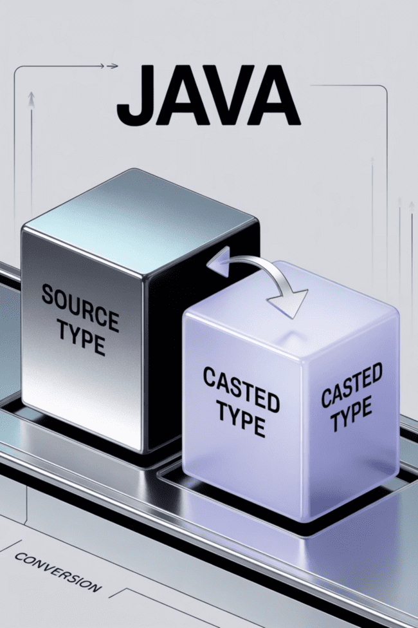


Type Casting in Java
Widening Casting
(Automatic)
int myInt = 9;double myDouble = myInt;
Smaller type → Larger type happens automatically. No data loss occurs. Java does this conversion for you.
Narrowing Casting
(Manual)
double myDouble = 9.78;int myInt = (int) myDouble;
Larger type → Smaller type requires explicit casting. Potential data loss (decimal part removed). You must specify the conversion.

Slide 13
Lab Tasks - Part 1
1
Factorial Program
2
Switch-Case for Months
Write a program that calculates the factorial of a given number using loops. Include input validation for negative numbers.
Create a program that takes a month number (1-12) and displays the month name using switch-case statement.
3
5-Digit Number Separation
4
Grading System
Write a program that takes a 5-digit number and separates each digit, displaying them individually.
Develop a program that converts numerical scores to letter grades (A, B, C, D, F) based on standard grading scales.

Slide 14

Solution: Factorial Program
Complete Solution
import java.util.Scanner;
public class Factorial {
public static void main(String[] args) {
Scanner input = new Scanner(System.in);
System.out.print("Enter a positive number: ");
int number = input.nextInt();
if (number < 0) {
System.out.println("Factorial not defined for negative numbers");
} else {
long factorial = 1;
for (int i = 1; i <= number; i++) {
factorial *= i;
}
System.out.println("Factorial of " + number + " = " + factorial);
}
input.close();
}
}
Key Learning Points
Using Scanner for user input
Input validation with if-else
For loop implementation
Long data type for large results
Proper resource management (closing Scanner)

Slide 15
Solution: Switch-Case for Months
import java.util.Scanner;
public class MonthName {
public static void main(String[] args) {
Scanner input = new Scanner(System.in);
System.out.print("Enter month number (1-12): ");
int month = input.nextInt();
switch (month) {
case 1:
System.out.println("January");
break;
case 2:
System.out.println("February");
break;
case 3:
System.out.println("March");
break;
case 4:
System.out.println("April");
break;
case 5:
System.out.println("May");
break;
case 6:
System.out.println("June");
break;
case 7:
System.out.println("July");
break;
case 8:
System.out.println("August");
break;
case 9:
System.out.println("September");
break;
case 10:
System.out.println("October");
break;
case 11:
System.out.println("November");
break;
case 12:
System.out.println("December");
break;
default:
System.out.println("Invalid month number!");
}
input.close();
}
}

Slide 16

Solution: 5-Digit Number Separation
import java.util.Scanner;
public class DigitSeparator {
public static void main(String[] args) {
Scanner input = new Scanner(System.in);
System.out.print("Enter a 5-digit number: ");
int number = input.nextInt();
if (number < 10000 || number > 99999) {
System.out.println("Please enter exactly 5 digits!");
} else {
System.out.println("Digits separated:");
int digit1 = number / 10000;
int digit2 = (number / 1000) % 10;
int digit3 = (number / 100) % 10;
int digit4 = (number / 10) % 10;
int digit5 = number % 10;
System.out.println(digit1 + " " + digit2 + " " + digit3 + " " + digit4 + " " + digit5);
}
input.close();
}
}
Mathematical Concepts Used
Integer division (/) extracts left digits
Modulo operator (%) extracts rightmost digit
Input validation for 5-digit requirement

Slide 17
Solution: Grading System
import java.util.Scanner;
public class GradingSystem {
public static void main(String[] args) {
Scanner input = new Scanner(System.in);
System.out.print("Enter numerical score (0-100): ");
int score = input.nextInt();
char letterGrade;
if (score >= 90) {
letterGrade = 'A';
} else if (score >= 70) {
letterGrade = 'B';
} else if (score >= 50) {
letterGrade = 'C';
} else {
letterGrade = 'F';
}
System.out.println("Score: " + score);
System.out.println("Letter Grade: " + letterGrade);
input.close();
}
}
Alternative: This could also be implemented using switch-case with score ranges divided by 10.

Slide 18

Lab 1 - Key Takeaways
Object-Oriented Foundation
Syntax Similarities
Java syntax is similar to C, C++, and C#, making it easier to learn if you know these languages. Key differences include garbage collection and platform independence.
Java is fundamentally object-oriented. Even simple programs require classes and methods. This structure promotes organized, reusable code.
Strong Typing System
Java enforces strict data type rules. This prevents many runtime errors but requires careful attention to variable declarations and type casting.

Slide 19
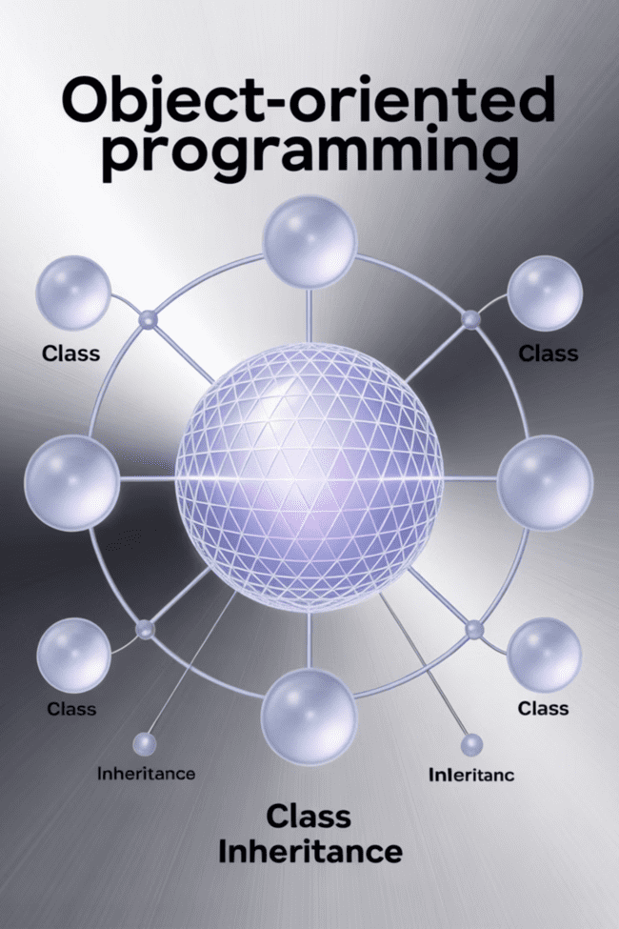
Lab 2: Understanding Class Definitions - I
Welcome to Lab 2! Now that you understand Java basics, we'll dive into object-oriented programming concepts. Classes and objects are the heart of Java programming.
In this lab, you'll learn how to create classes, instantiate objects, and understand the relationship between blueprints (classes) and instances (objects). We'll also introduce BlueJ, a beginner-friendly development environment.

Slide 20

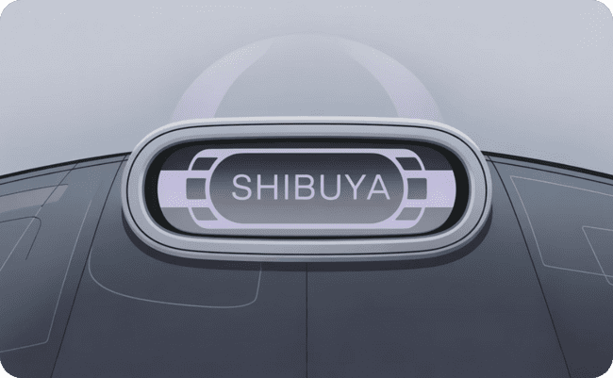

What is a Class?
Blueprint Concept
Attributes (Properties)
Methods (Behaviors)
A class is like a blueprint or template that defines the structure and behavior of objects. Just as an architect's blueprint shows how to build houses, a class shows how to create objects.
Attributes are variables that store data about the object. For a Car class, attributes might include color, model, year, and speed. These represent the object's characteristics.
Methods are functions that define what the object can do. For a Car class, methods might include start(), stop(), accelerate(), and brake(). These represent the object's behaviors.

Slide 21
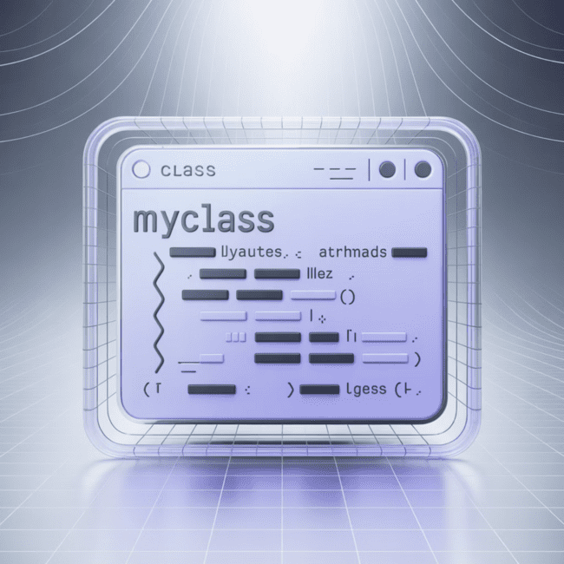

Example Class Definition
MyClass.java
public class MyClass {
// Attribute (field)
int x = 5;
// Method to display the value of x
public void displayX() {
System.out.println("Value of x: " + x);
}
// Method to change the value of x
public void setX(int newValue) {
x = newValue;
}
}
This simple class has one attribute (x) and two methods. The attribute stores data, while methods provide functionality to interact with that data.
Naming Convention: Class names should start with a capital letter and use CamelCase (e.g., MyClass, StudentRecord, BankAccount).

Slide 22
Objects in Java
01
02
03
Creating an Object
Accessing Attributes
Calling Methods
MyClass obj = new MyClass();
System.out.println(obj.x); // Prints 5
obj.displayX(); // Calls the methodobj.setX(10); // Changes x to 10
Use the new keyword followed by the class constructor. This creates an instance of the class in memory.
Use dot notation to access public attributes. The object name followed by a dot, then the attribute name.
Use dot notation to call methods. The object name followed by a dot, then the method name with parentheses.
Each object created from a class maintains its own copy of the attributes, allowing multiple objects with different states.

Slide 23
Multiple Classes Example
Main.java
Second.java
public class Main {
public static void main(String[] args) {
Second myObj = new Second(); // create object of Second
System.out.println(myObj.x); // print value of x
}
}
public class Second {
int x = 5; // attribute
// Method to print a message
public void printMessage() {
System.out.println("Hello from Second class!");
}
}
Key Points:
Key Points:
Contains the main() method
Creates object of Second class
Contains class definition
Entry point of the program
Has attributes and methods
Separate file from Main class

Slide 24

Running Multi-Class Programs
1
Compile Both Files
javac *.java
This command compiles all Java files in the directory, creating .class files for each source file.
2
Run Main Class
java Main
Execute the class containing the main() method. Java will load other classes as needed.
3
Expected Output
5
The program creates a Second object and prints the value of its x attribute, which is 5.

Slide 25





BlueJ IDE Introduction
Visual Class Diagrams
Interactive Object Creation
BlueJ shows your classes as boxes with visual connections, making it easy to understand class relationships and project structure at a glance.
Right-click on classes to create objects instantly. No need to write main() methods for testing - perfect for experimenting with your code.
Object Inspector
Direct Method Calls
Inspect object states in real-time. View attribute values and call methods directly on created objects through the graphical interface.
Test individual methods without writing test code. Right-click on objects to see available methods and call them with different parameters.

Slide 26

BlueJ Features in Detail
Getting Started with BlueJ
Download and install BlueJ from www.bluej.org
Create a new project
Add classes using "New Class" button
Write your code in the editor
Compile by clicking "Compile" button
Right-click classes to create objects
Object Bench
The red area at the bottom shows created objects. You can:
Right-click objects to call methods
Inspect object attributes
Pass objects as parameters to methods
Remove objects when done testing

Slide 27
Lab Tasks - Part 2
1
2
BlueJ Shapes & Objects
Student Record Management System
Objective: Explore BlueJ's built-in shapes demo
Objective: Create a complete class-based system
Open the "shapes" demo project in BlueJ
Design a Student class with attributes (name, ID, grades)
Create Circle and Square objects
Add methods for setting/getting student information
Use methods to move, resize, and change colors
Create methods to calculate average grades
Build a simple house using multiple shape objects
Test your class by creating multiple Student objects
Experiment with method parameters
Demonstrate different students with different data
This hands-on exercise helps you understand object interaction and method calls in a visual way.
This project reinforces class design, object creation, and method implementation.

Slide 28

Task 1 Solution: BlueJ Shapes Demo
Step-by-Step Guide
Open Demo: File → Open Project → shapes
Create Objects: Right-click Circle → new Circle()
Make Visible: Right-click circle1 → makeVisible()
Move Shape: Right-click circle1 → slowMoveHorizontal(60)
Resize: Right-click circle1 → changeSize(80)
Color Change: Right-click circle1 → changeColor("red")
Building a House
Combine shapes to create a house:
Square for the main structure
Triangle for the roof
Small squares for windows
Rectangle for the door
This exercise demonstrates how objects maintain their own state while providing methods to modify their behavior and appearance.

Slide 29
Task 2 Solution: Student Class Design
public class Student {
// Attributes
private String name;
private int studentID;
private double[] grades;
private int gradeCount;
// Constructor
public Student(String studentName, int id) {
name = studentName;
studentID = id;
grades = new double[10]; // Maximum 10 grades
gradeCount = 0;
}
// Method to add a grade
public void addGrade(double grade) {
if (gradeCount < grades.length) {
grades[gradeCount] = grade;
gradeCount++;
} else {
System.out.println("Cannot add more grades!");
}
}
// Method to calculate average
public double calculateAverage() {
if (gradeCount == 0) return 0.0;
double sum = 0;
for (int i = 0; i < gradeCount; i++) {
sum += grades[i];
}
return sum / gradeCount;
}
}

Slide 30
Student Class - Additional Methods
// Getter methods
public String getName() {
return name;
}
public int getStudentID() {
return studentID;
}
// Display method
public void displayStudentInfo() {
System.out.println("Student Name: " + name);
System.out.println("Student ID: " + studentID);
System.out.println("Number of grades: " + gradeCount);
System.out.println("Average grade: " + String.format("%.2f", calculateAverage()));
System.out.println("Letter grade: " + getLetterGrade());
}
// Method to get letter grade
public char getLetterGrade() {
double avg = calculateAverage();
if (avg >= 90) return 'A';
else if (avg >= 80) return 'B';
else if (avg >= 70) return 'C';
else if (avg >= 60) return 'D';
else return 'F';
}
}
These methods demonstrate encapsulation and provide controlled access to the object's data and functionality.

Slide 31
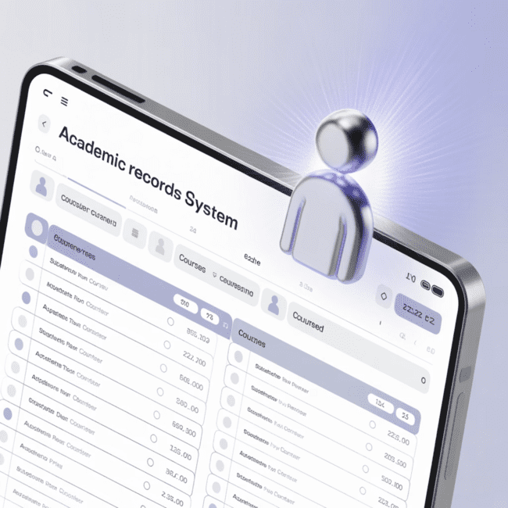
Testing the Student Class
Creating and Testing Objects
public class StudentTest {
public static void main(String[] args) {
// Create student objects
Student alice = new Student("Alice Johnson", 12345);
Student bob = new Student("Bob Smith", 67890);
// Add grades
alice.addGrade(95.0);
alice.addGrade(87.5);
alice.addGrade(92.0);
bob.addGrade(78.0);
bob.addGrade(82.5);
bob.addGrade(75.0);
// Display information
alice.displayStudentInfo();
System.out.println("Letter Grade: " + alice.getLetterGrade());
System.out.println();
bob.displayStudentInfo();
System.out.println("Letter Grade: " + bob.getLetterGrade());
}
}
Expected Output
Student Name: Alice Johnson
Student ID: 12345
Number of grades: 3
Average grade: 91.50
Letter Grade: A
Student Name: Bob Smith
Student ID: 67890
Number of grades: 3
Average grade: 78.50
Letter Grade: C

Slide 32
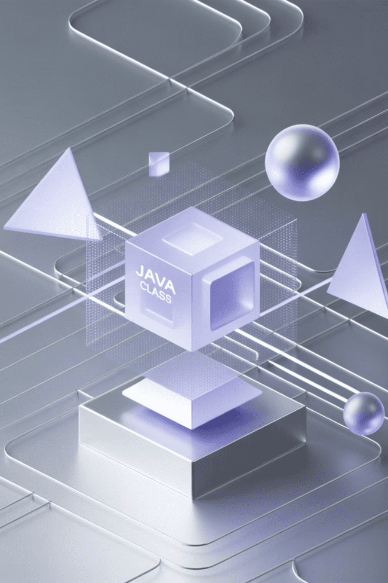
Lab 2 - Key Takeaways
Objects Follow Blueprints
Multiple Objects, Multiple States
Classes define the template; objects are instances created from that template. Each object has its own copy of attributes but shares the same methods.
You can create many objects from one class, and each maintains its own unique state. Changes to one object don't affect others.
Encapsulation Benefits
Private attributes with public methods provide controlled access to data, preventing unauthorized modifications and ensuring data integrity.

Slide 33
Summary of Lab 1 & Lab 2
Lab 1 Foundations
1
Established Java fundamentals: installation, syntax, data types, variables, and basic programming constructs. Completed hands-on coding exercises with practical applications.
2
Lab 2 Object-Oriented Concepts
Introduced classes and objects, the cornerstone of Java programming. Learned to create blueprints, instantiate objects, and understand encapsulation principles.
Development Environment
3
Explored BlueJ IDE for visual learning and interactive object manipulation. Gained practical experience with both command-line and graphical development approaches.
4
Practical Applications
Built real-world projects including mathematical calculations, grading systems, and student record management. Applied theoretical concepts to solve actual programming problems.

Slide 34
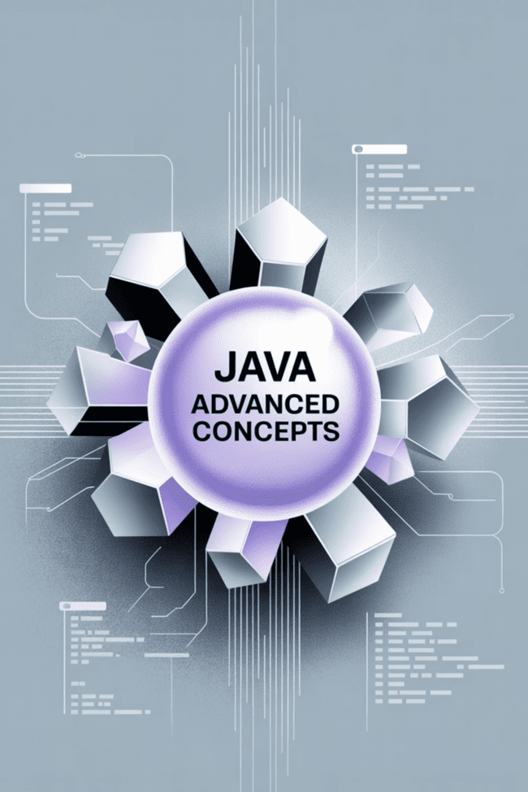




Next Steps - Preview of Lab 3
Constructors & Initialization
Learn how to properly initialize objects with custom constructors, parameter passing, and constructor overloading for flexible object creation.
2
Method Overloading
Explore how to create multiple methods with the same name but different parameters, providing flexibility in how methods can be called.
Inheritance Basics
Discover how classes can inherit properties and methods from other classes, promoting code reuse and establishing hierarchical relationships.
Arrays and Collections
Master working with arrays and basic collections to store and manipulate multiple data items efficiently in your programs.

Slide 35

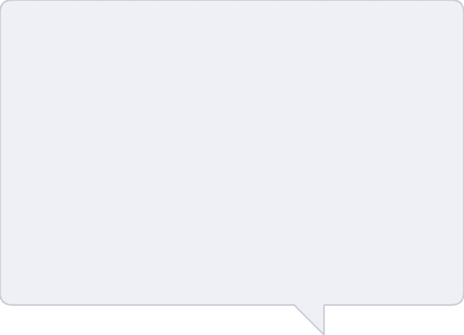
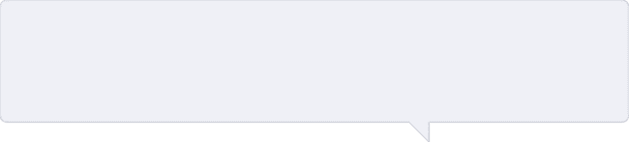
Thank You & Q&A
🎉 Congratulations!
❓ Questions Welcome
You've successfully completed your first two Java labs! You now understand the fundamentals of Java programming and object-oriented concepts.
Please feel free to ask questions about anything we covered today. Understanding these concepts thoroughly will help you succeed in future labs.
📚 Keep Practicing
The best way to master programming is through practice. Try modifying the lab exercises and creating your own simple programs between sessions.
Remember: Programming is a skill that improves with practice. Don't hesitate to experiment with the code examples and try new approaches!

